Slide 1


JavaScript Applications: Course Introduction
Course Program, Evaluation, Exams, Resources
Telerik Software Academy
Learning & Development Team
http://academy.telerik.com

Slide 2

Table of Contents
What is next in the Academy?
The JavaScript Applications Course Program
Exams and Evaluation
Standard Criteria
Resources for the Course

Slide 3

JavaScript Applications
About to make the next step

Slide 4

What's Coming Next?
JavaScript Applications
Continuation of JS OOP & JS DOM & UI
Creating web applications with JavaScript
Pretty much the same
Lectures 2 times a week
Practical exam on 29-Jul-2014
The course exam
Creating a SPA application based on a given REST API

Slide 5

JavaScript Applications: Course Program
Material to cover during the course

Slide 6
JavaScript Applications: Course Program
"JavaScript Applications" course introduction
Course Program, Exams, Evaluation
Best practices for writing JavaScript
Naming, scoping, this, 'use strict', etc…
Dive into Underscore.js
JavaScript utility library
Iterating, filtering, and more

Slide 7


JavaScript Applications: Course Program (2)
Web Storages
localStorage, sessionStorage, cookies
Promises and Async programming in JavaScript
Async programming, Callbacks, Promises
HTTP & AJAX
HTTP basics, HTTP methods, HTTP headears
AJAX principles, REST APIs, Web Services

Slide 8
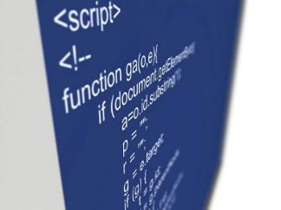
JavaScript Applications: Course Program (3)
Consuming Web Services
xhr, performing HTTP requests with JavaScript
Honeying the request – methods, headers
Using jQuery AJAX for HTTP requests
App clouds for persistent data
Telerik Backend services
Content types
Users

Slide 9
JavaScript Applications: Course Program (4)
Unit Testing in JavaScript
Creating test suites and unit tests
Testing DOM manipulation
Async tests
Mocking and Spies
App Architecture
SPA applications, separation of concerns, principles
Practical exam

Slide 10




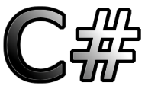
Evaluation
Thank God There Are Bonuses!

Slide 11

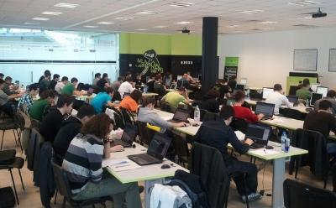
JavaScript Applications: Evaluation
Evaluation components
Practical exam – 55%
Exam evaluation – 10%
Homework – 15%
Homework evaluation – 10%
3 peer reviews per homework
Attendance in class – 10%
Bonuses
Forums activity – bonus up to 5%

Slide 12
Practical Exam
Your task will be to create a SPA application by given REST API written in Node.js
Create a client running in the browser
Fetch data from the REST API and visualize it
Send data to the REST API
Validate input and handle errors
Maybe writing some Unit tests in the selected framework
Using Require.js

Slide 13








Resources
What We Need in Addition to this Course Content?

Slide 14
JavaScript Resources
Mozilla Development Network (MDN)
https://developer.mozilla.org
Previous JavaScript apps courses:
School Academy Feb 2014
Software Academy Jun 2013

Slide 15
Course Web Site & Forums
Register for the "Telerik Academy Forums":
Discuss the course exercises with your colleagues
Find solutions for the exercises
Share source code / discuss ideas
The JavaScript Fundamentals official web site:
http://forums.academy.telerik.com/questions/front-end-development/js-apps
academy.telerik.com/student-courses/web-design-and-ui/javascript-applications

Slide 16
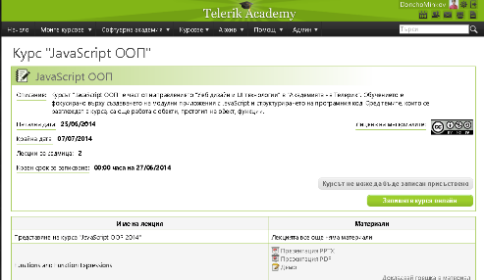
Telerik Integrated Learning System (TILS)
The Telerik Integrated Learning System (TILS)
www.telerikacademy.com
Important resource for all students
Homework submissions
Homework peer reviews
Presence cards with barcode
Reports about your results
telerikacademy.com/Courses/Courses/Details/182

Slide 17



Required Software
Software needed for this course:
Sublime Text 2/3
WebStorm
Brackets
Notepad ++
Microsoft Visual Studio 2013 or Visual Studio Express 2013 (free version of VS 2013)

Slide 18



JavaScript Applications Course Introduction
http://academy.telerik.com

Slide 19



Free Trainings @ Telerik Academy
Web Design and UI Technologies @ Telerik Academy
html5course.telerik.com
Telerik Software Academy
academy.telerik.com
Telerik Academy @ Facebook
facebook.com/TelerikAcademy
Telerik Software Academy Forums
forums.academy.telerik.com

